Slide 1


Slide 2


WEB-BASED DENTAL CLINIC MANAGEMENT SYSTEM
Second Year Project Synopsis
Submitted by
ROLL | NAME
2301730310 | RIDHIMA SHARMA
2301730304 | UMA MISHRA
Industry Mentor: Dr. Tushar Dubey
Faculty Mentor: Dr. Surabhi Shankar
Notes:
New Courses replaced with New Programmes
2

Slide 3

Project Overview
This project is a web application where patients can book their dental appointments online.
It also provides a separate login for doctors, allowing them to view all appointments in one place.
The system automatically assigns a priority level to each patient based on the seriousness of their dental problem.
The aim is to manage appointments more efficiently, especially urgent cases that need immediate attention.
Notes:
New Courses replaced with New Programmes
3

Slide 4
About the Problem
Traditional dental appointment booking is manual and inefficient.
No system to prioritize critical dental cases based on severity.
Delays in handling emergencies like bleeding or severe pain.
Increased chances of booking errors and patient dissatisfaction.
Need for an automated, priority-based appointment system.
ISSUES:
No automatic method to identify and prioritize urgent dental problems.
Mismanagement and booking clashes due to manual handling.
NEED OF SOLUTION:
An automated online system that books appointments.
Auto-detects severity of patient's problems.
Helps doctors attend serious cases first.
Notes:
New Courses replaced with New Programmes
5

Slide 5
Problem Statement
Managing appointments manually is slow and disorganized.
Patients with critical issues may wait unnecessarily.
Staff finds it difficult to manage multiple bookings efficiently.
Need for an online, priority-based system to optimize clinic operations and improve patient care.
Notes:
New Courses replaced with New Programmes
5

Slide 6
Objectives
Provide a user-friendly web portal for booking dental appointments.
Develop an automated priority assignment logic based on patient complaints.
Design a secure login portal for doctors to manage appointments.
Ensure faster emergency handling and better clinic workflow.
Notes:
New Courses replaced with New Programmes
6

Slide 7
Methodology, Tools, and Techniques
Frontend: HTML, Tailwind CSS
Backend: TypeScript, JavaScript, Next.js
Database: JSON storage / serverless configuration (or mention SQLite if used)
Other Tools: GitHub for version control, Vercel for deployment
Config Files: package.json, tailwind.config.js, tsconfig.json, etc.
Notes:
New Courses replaced with New Programmes
7

Slide 8
Methodology
Planning and Requirement Analysis: Identified key features: appointment form, auto-priority setting, doctor login, dashboard view.
Designing and Development: Designed webpages using HTML5, CSS3, Bootstrap 5, and Tailwind CSS.
Developed JavaScript logic to detect patient urgency and assign priority automatically.
Testing and Deployment: Validated forms, tested priority logic across different scenarios, and deployed project to GitHub for version control.
Notes:
New Courses replaced with New Programmes
8

Slide 9
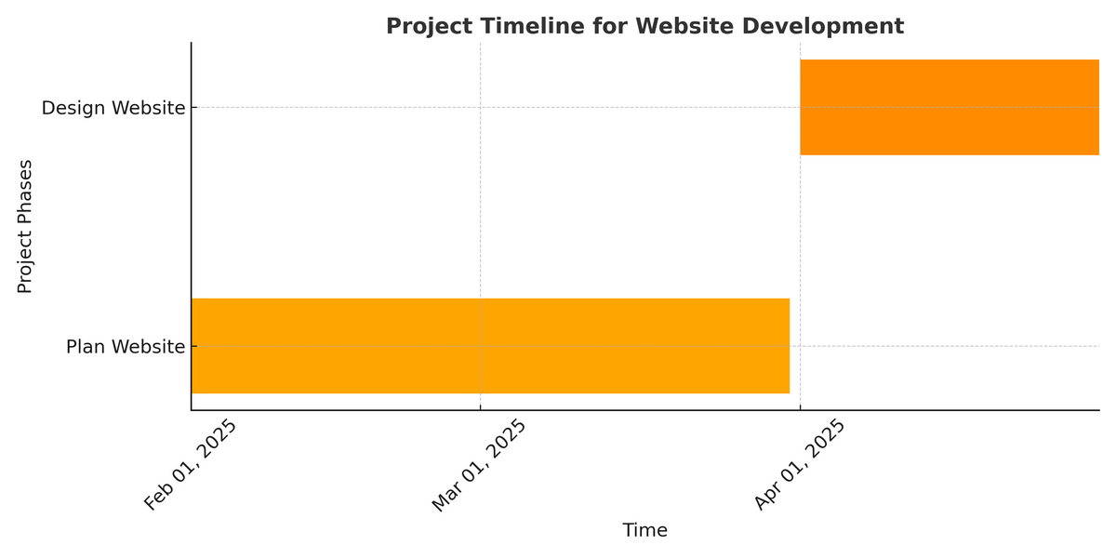
Project Timeline
Notes:
New Courses replaced with New Programmes
9

Slide 10
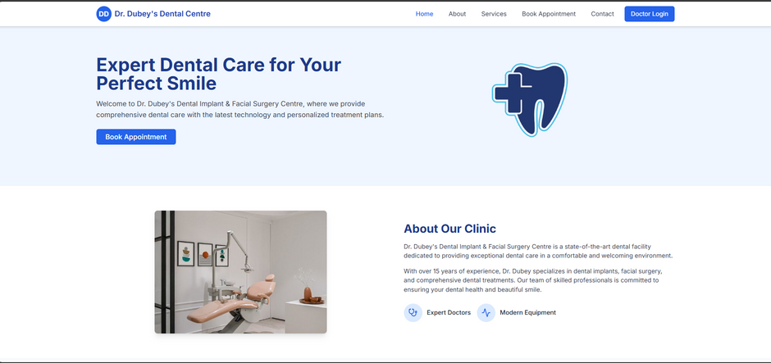
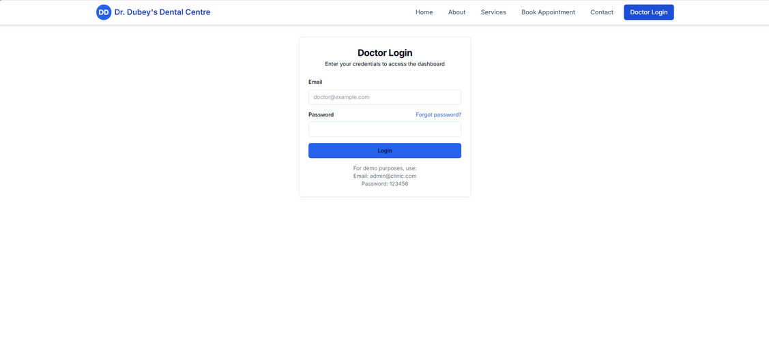

Slide 11
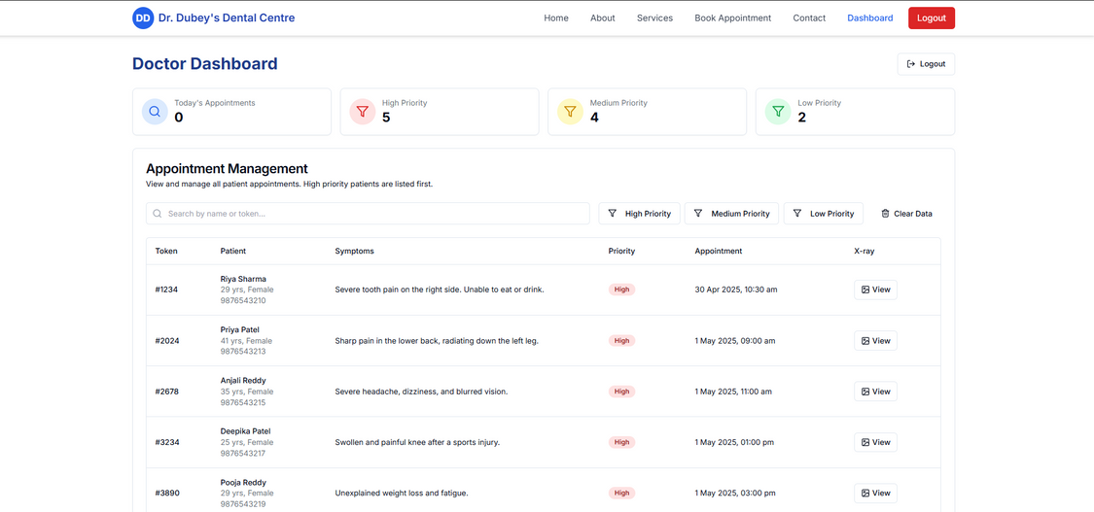
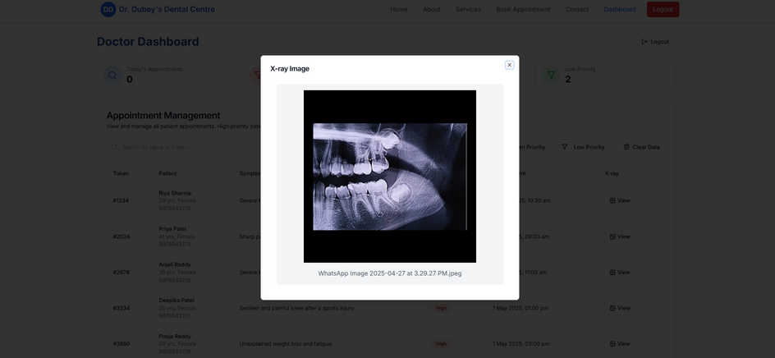

Slide 12
Expected Results & Impact
Expected Results:
The system will enable efficient appointment booking, automatic patient prioritization, and smooth dashboard management for doctors.
Efficient Management:
Faster patient handling and better organization of appointments.
Priority-based Attention:
Critical dental cases are identified and handled immediately.
Improved Patient Experience:
Patients receive quicker confirmations and faster emergency care.
Impact:
Enhances operational efficiency of the clinic.
Reduces human errors and manual workload.
Increases trust and satisfaction among patients by providing timely dental care.
Notes:
New Courses replaced with New Programmes
10

Slide 13
References
Websites and Online Learning:
W3Schools: HTML, CSS, and JavaScript tutorials.
https://www.w3schools.com/
Bootstrap Documentation: Official Bootstrap 5 components and design references.
https://getbootstrap.com/
Tailwind CSS Documentation: Utility-first CSS framework documentation.
https://tailwindcss.com/docs
YouTube Tutorials: Guides for building responsive websites and booking systems.
https://www.youtube.com/
GitHub: Platform for version control and code repository management.
https://github.com/
Notes:
New Courses replaced with New Programmes
11

Slide 14
THANK YOU

